Slide 1
A Detailed Look into Belarus Used Car Market
By : Team Pattern 6
Kartik Jain
Aasish Kumar
Aihan Liu
Ali Can Mutlu
Kurtis Shen

Slide 2
Agenda
Introducing the Topic
Data Pre-Processing
EDA
Showcasing the Graphs
Hypothesis Testing
Questions
SMART Questions

Slide 3
Research Proposal
What factors determine the prices of cars in the used car market?
Manufacturer Name?
Color?
Engine Capacity?
Odometer Value?
Engine Type?
Year Produced?

Slide 4
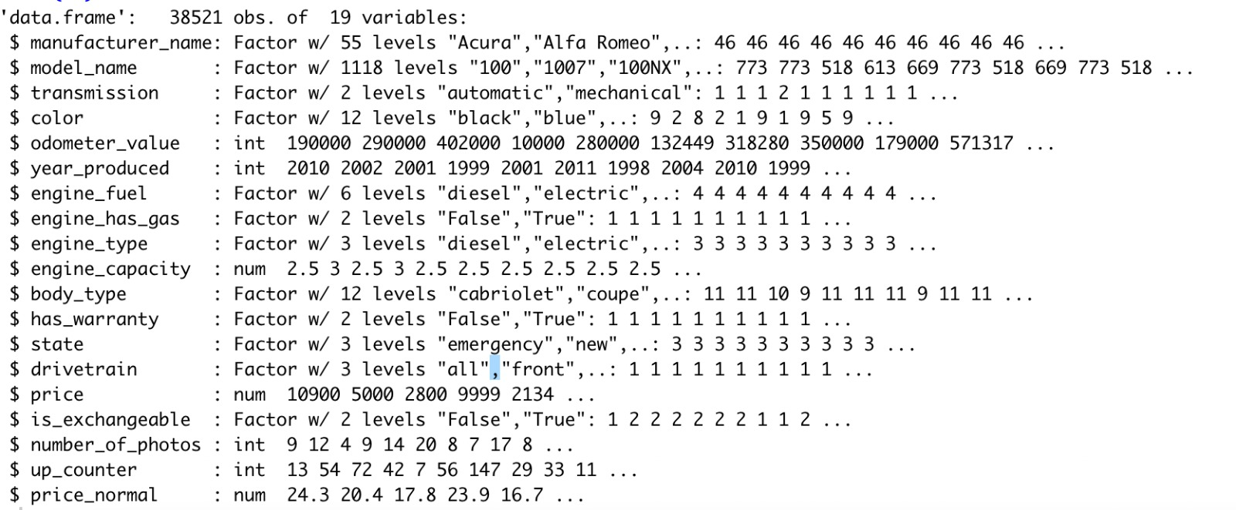
Data Set Information
Used car catalog for Belarus for the year 2019
Source: Kaggle
No. Observations: 38521
No. of variables: 19
MeanPrice: 6639.97$
Std.DevPrice=6428.15$

Slide 5
Data Pre-Processing
Dropping Null Values : engine_capacity(10)
Factor Checking
Name Change: Price USD – Price

Slide 6
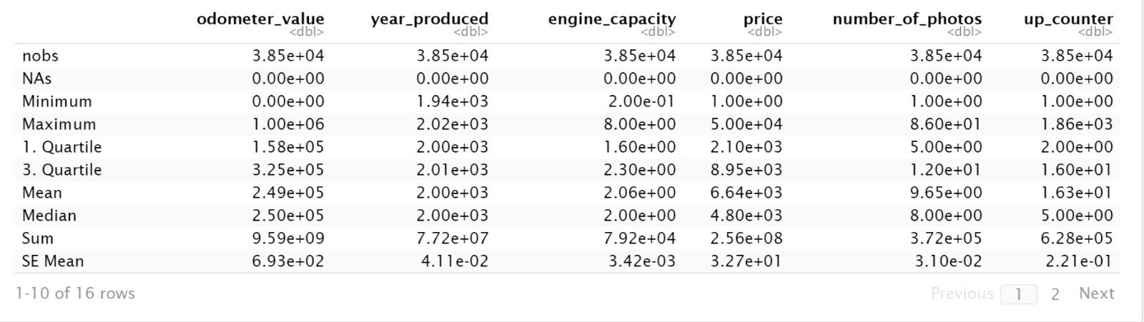
Descriptive – Basic Statistics for the Variables

Slide 7
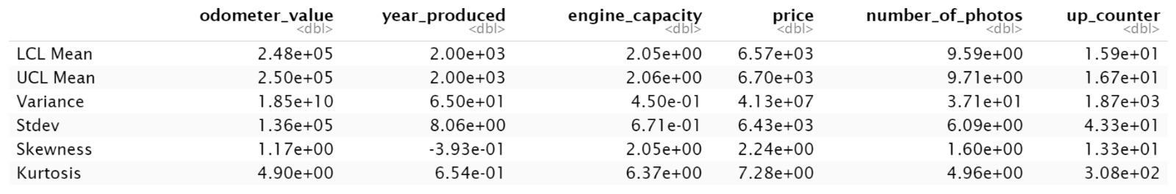
Descriptive – Basic Statistics for the Variables
Notes:
Highlight Standard Deviation

Slide 8
SMART QUESTIONS

Slide 9
SPECIFIC
Is it possible to build a model to find a relationship between car prices by looking at different factors that include numerical, categorical values and further use the model to predict car prices?

Slide 10
Measurable
Is it possible to measure metrics such as r-square, MAE, MSE and RMSE with the data set categories in towards coming up with a model?

Slide 11
Achievable
Based on the preliminary analysis that the team concluded is it possible to find a pattern between target variable(car price) and the independent variable?

Slide 12
Relevant
Can the research help the sellers and buyers in the used car market to make an informed decision about the price of the vehicle?

Slide 13
Time Oriented
Will the final modeling analysis be completed by December, 7th with the presentation?

Slide 14
Exploratory Data Analysis

Slide 15
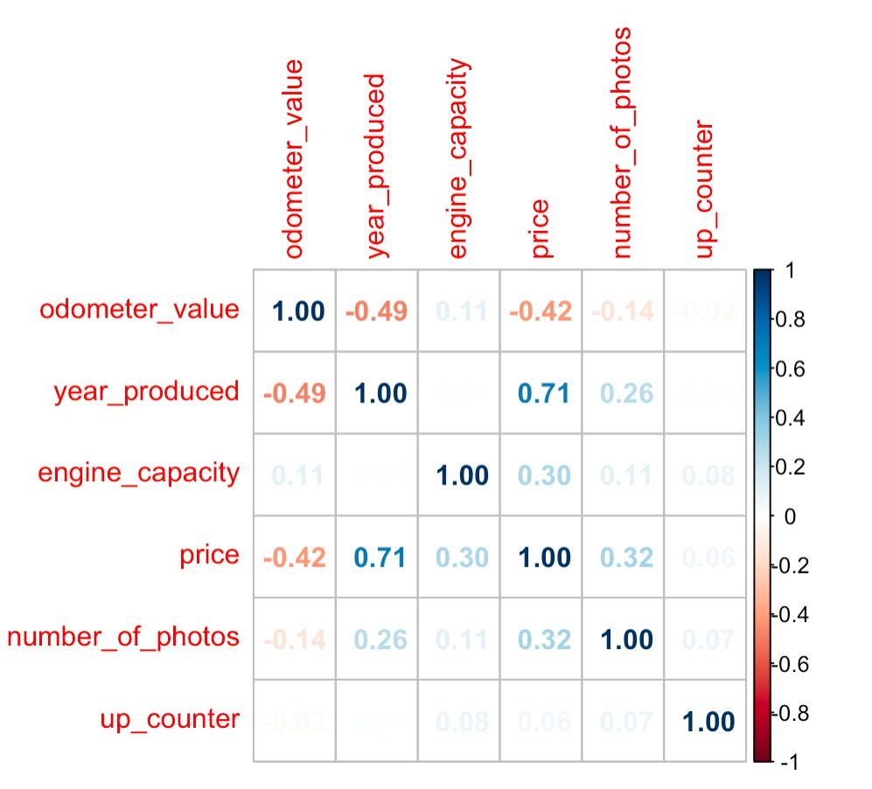

Correlation Plot

Slide 16
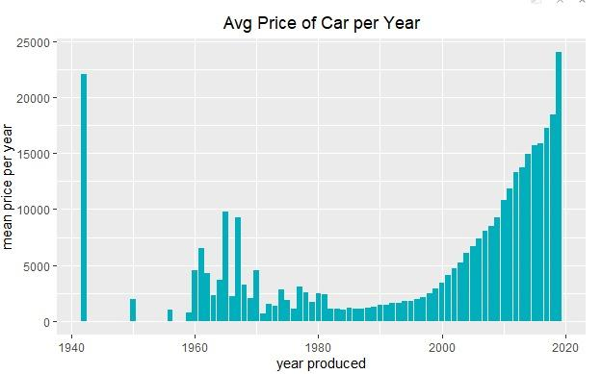
Mean Price of Car vs Year Made – Do you see anything interesting?
Notes:
Add an arrow to the left side

Slide 17
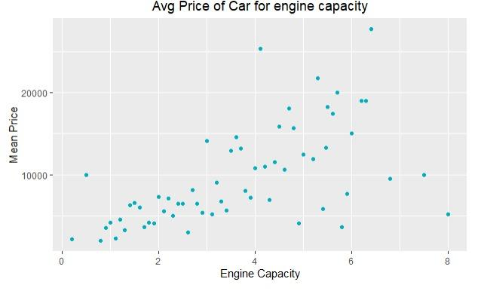
Mean Price of Car vs Engine Capacity
- Do you see anything interesting?
Correlation Coefficient: 0.6

Slide 18
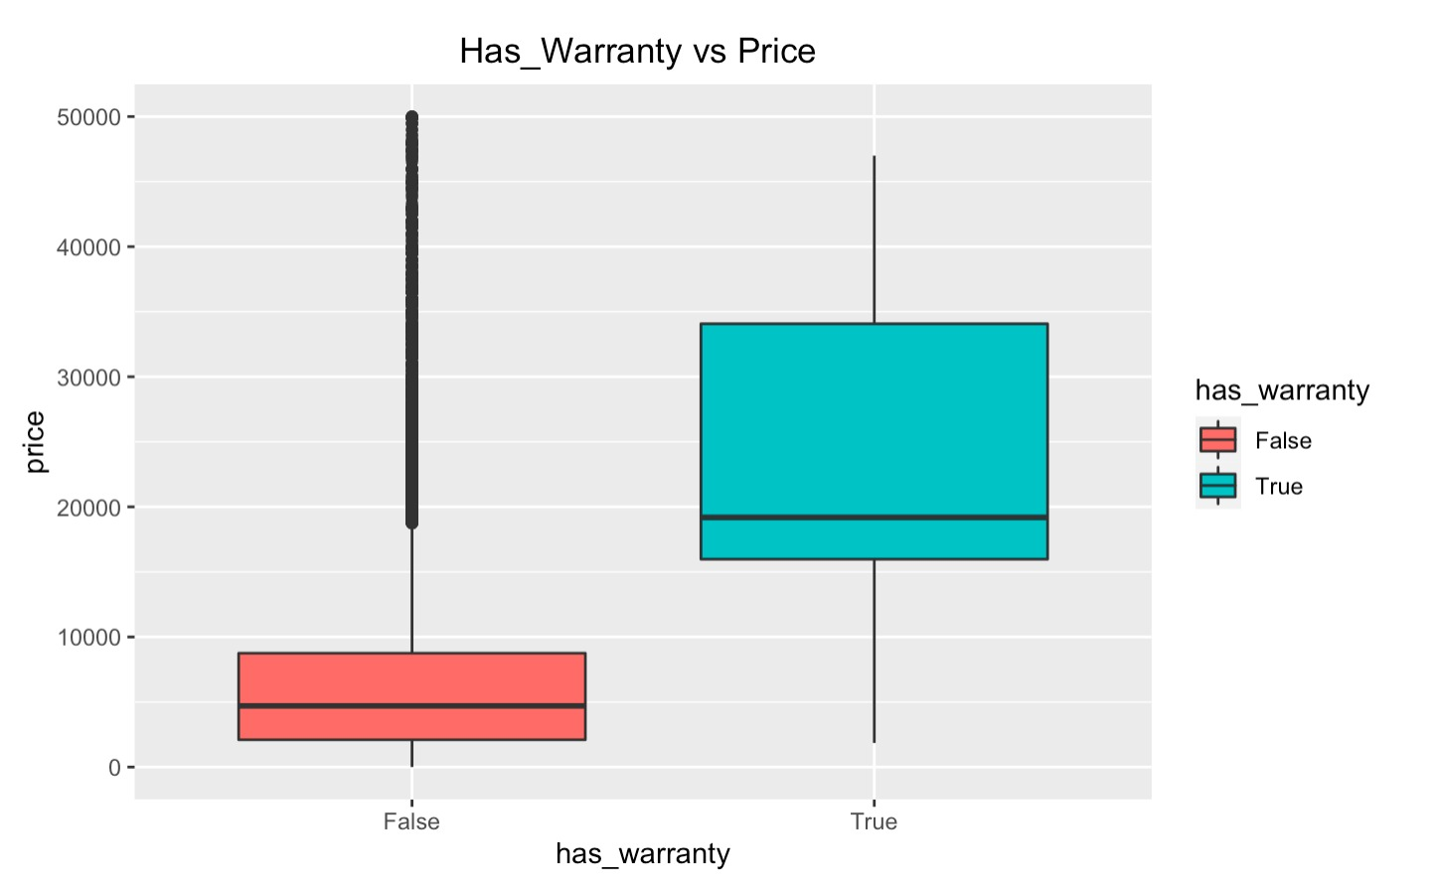
Has_Warranty vs Price
t = 37, df = 452, p-value <2e-16
T-Test Results
Notes:
add a portrait type box

Slide 19
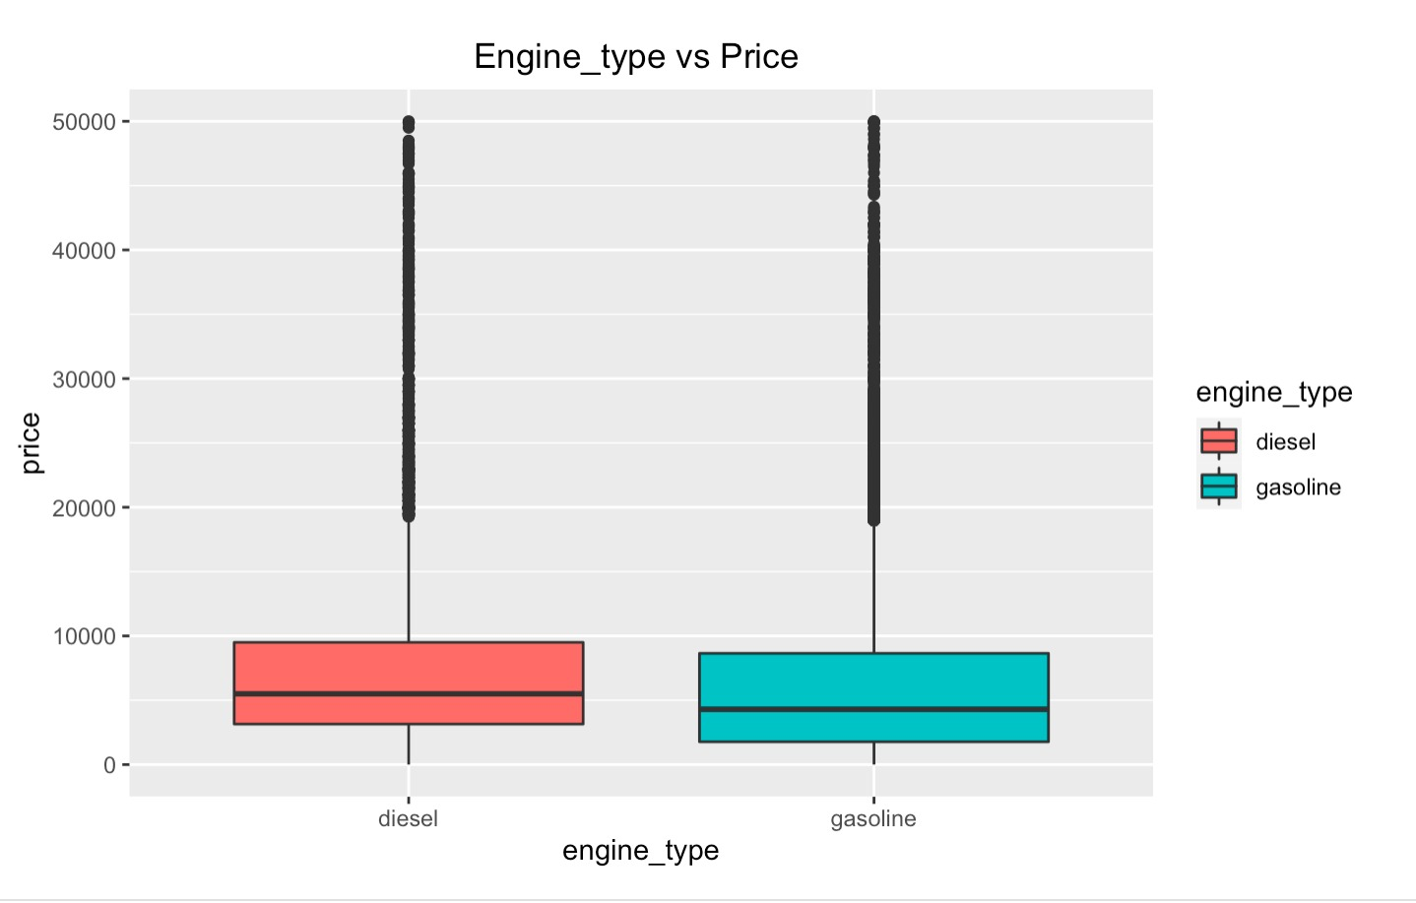
Engine_Type vs Price
t = 16, df = 24452, p-value <2e-16
Notes:
Edit this to make it exactly the same as the previous one

Slide 20
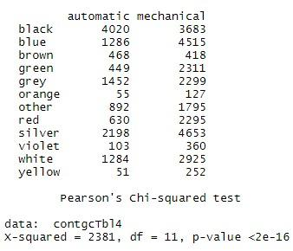
Colors vs Transmission

Slide 21
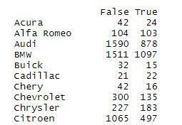
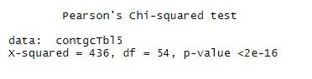
Manufacturer Name vs Is_Exchangable

Slide 22
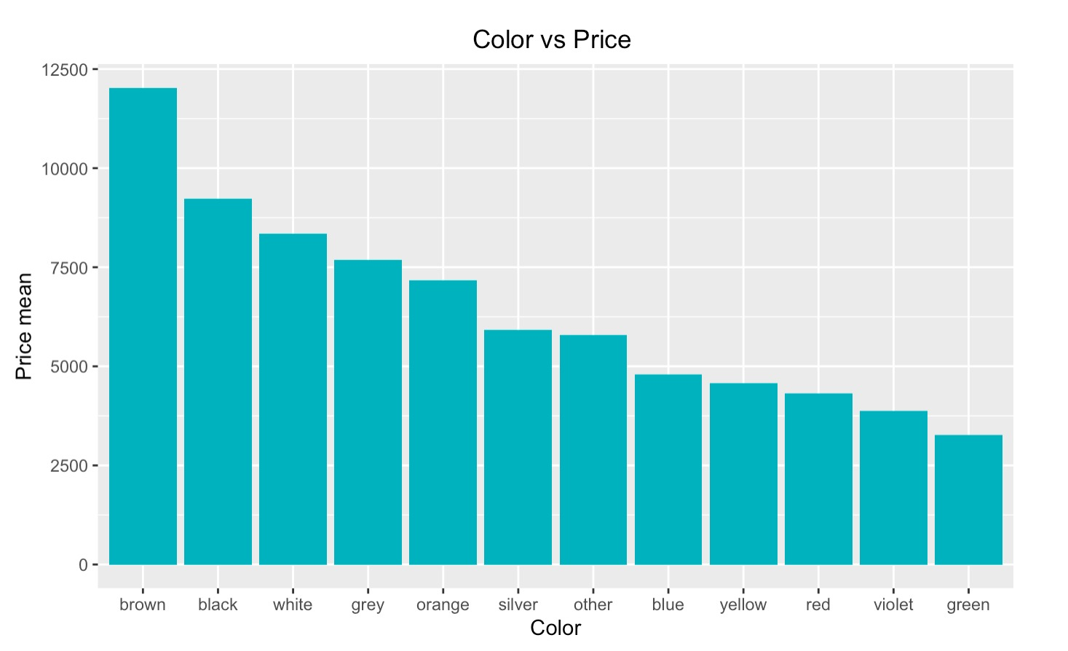
The Price Difference Between Different Colors
## Df Sum Sq Mean Sq F value Pr(>F)
## color 11 1.70e+11 1.55e+10 420 <2e-16 ***
Notes:
dont forget to mention that it is mean price

Slide 23
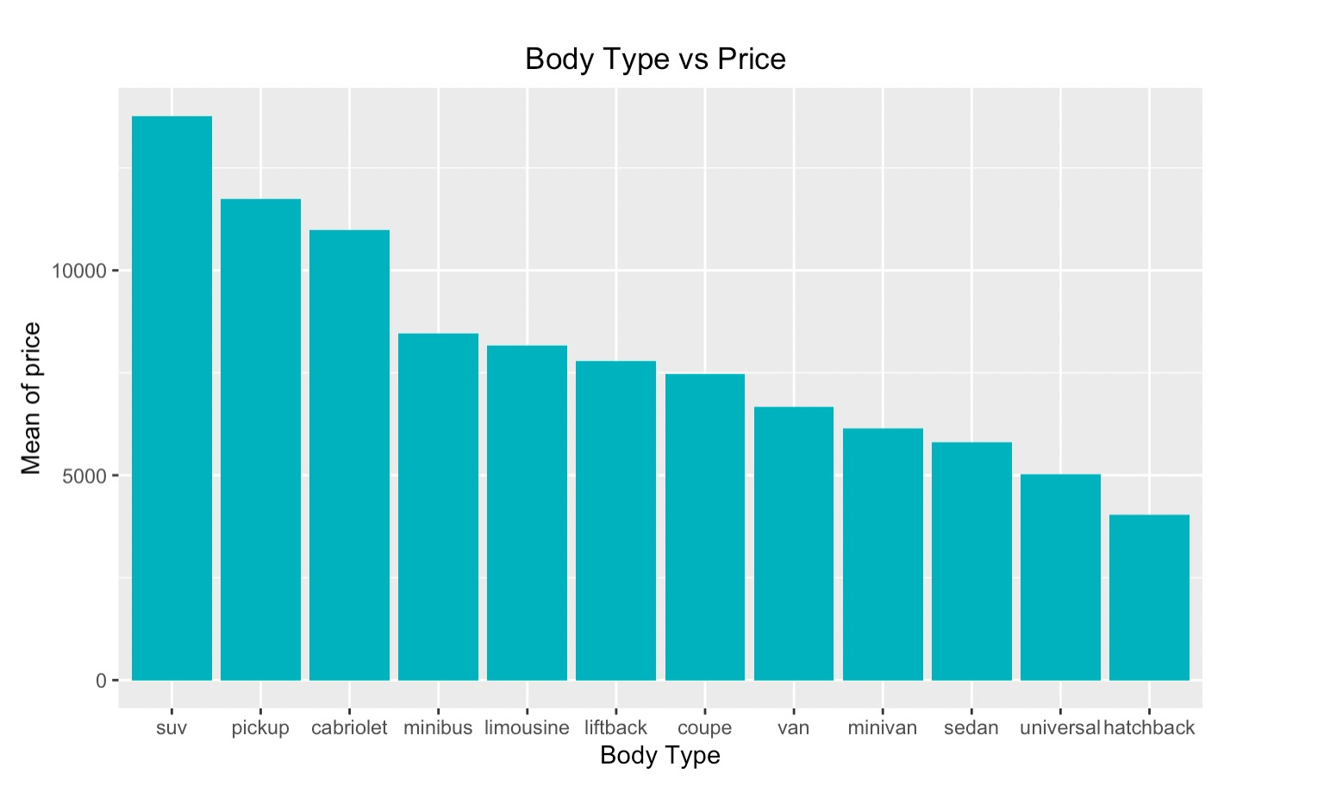
Change in Price and Body Type
## Df Sum Sq Mean Sq F value Pr(>F)
## body_type 11 3.50e+11 3.18e+10 988 <2e-16 ***
Notes:
dont forget to mention its mean price

Slide 24
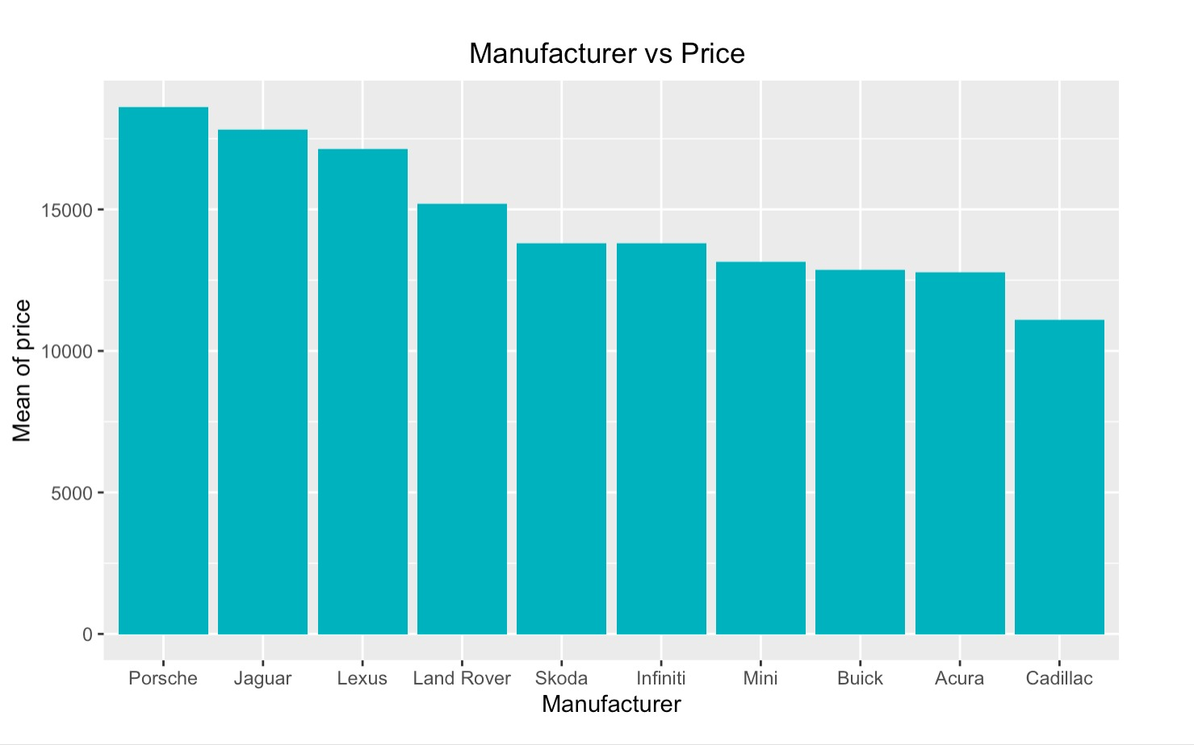
Relationship Between Price and Top 10 Manufacturers
## Df Sum Sq Mean Sq F value Pr(>F)
## manufacturer_name 54 2.94e+11 5.45e+09 162 <2e-16 ***
Notes:
Dont forget to mention that it is mean price

Slide 25
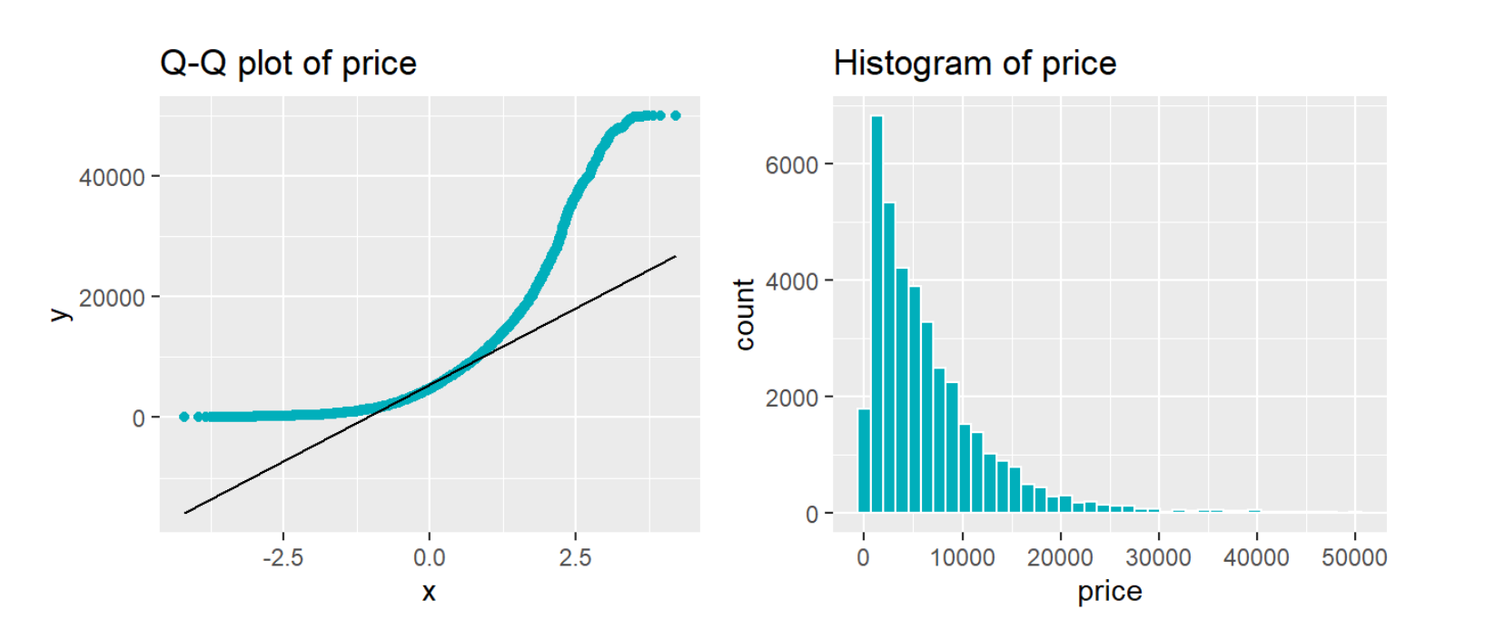
Q-Q Normalization
## One-sample Kolmogorov-Smirnov test
## D = 0.2, p-value <2e-16
## alternative hypothesis: two-sided

Slide 26
What is the story?
year_produced
Manufacture_name
odometer_value
color
transmission
engine_type
engine_capacity
body_type
Price

Slide 27
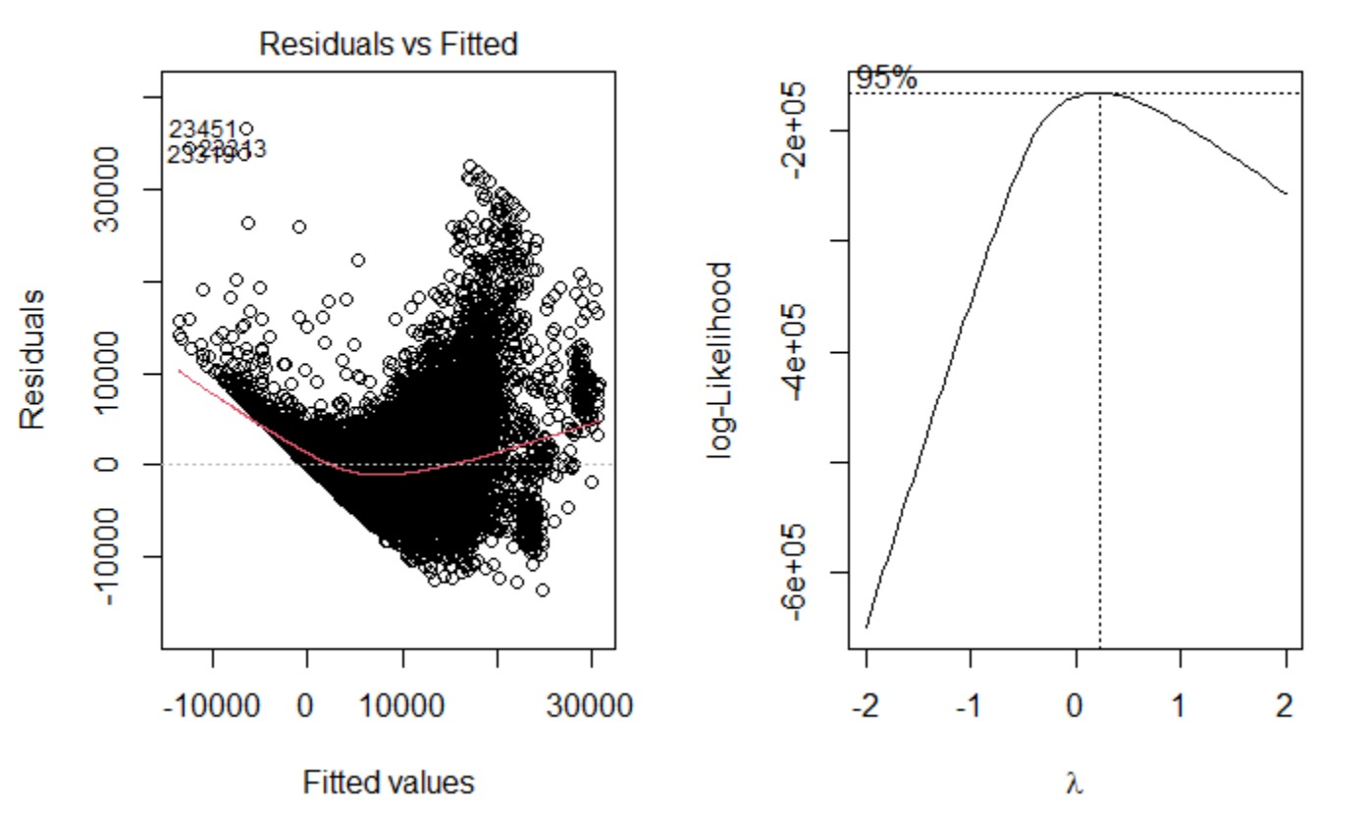
Data Transformations

Slide 28
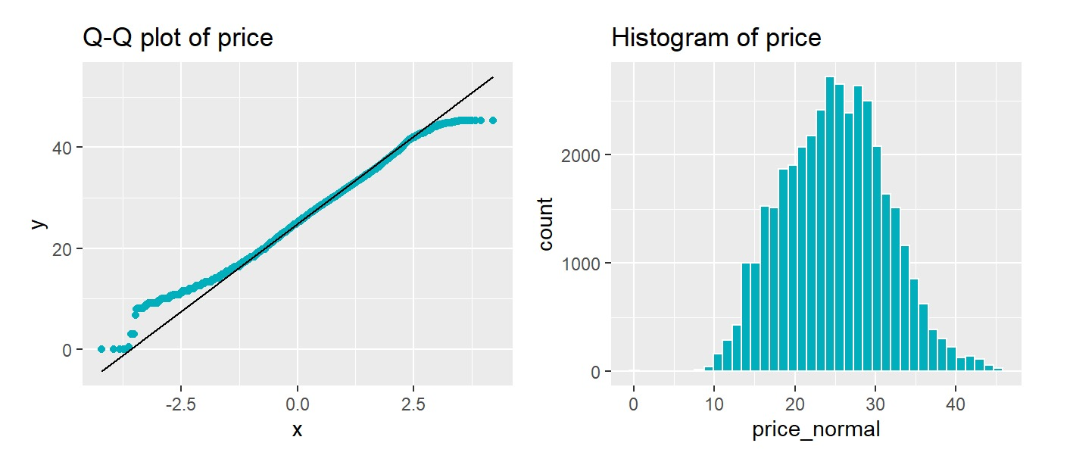
Transform the Data Normality

Slide 29
Normalizing the Target Variable

Slide 30
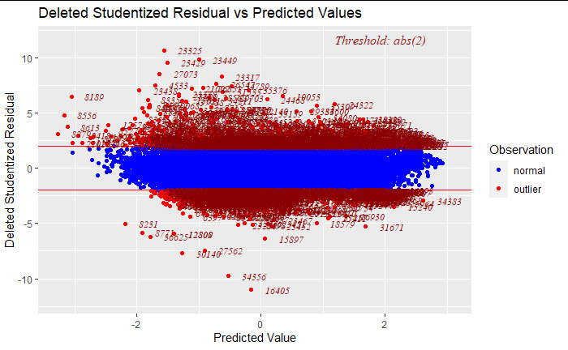
Outlier Checking for Target Variable

Slide 31
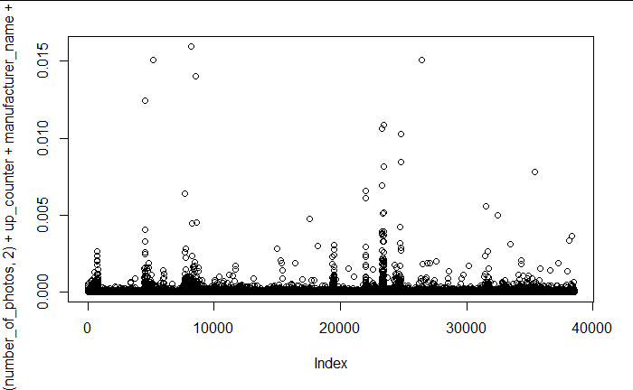
Outlier Checking for X

Slide 32
4 Models

Slide 33
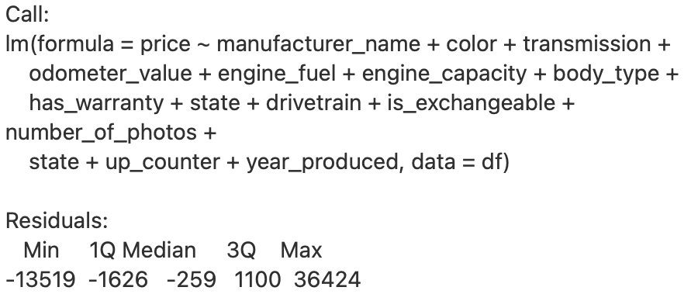
1st Base Model

Slide 34
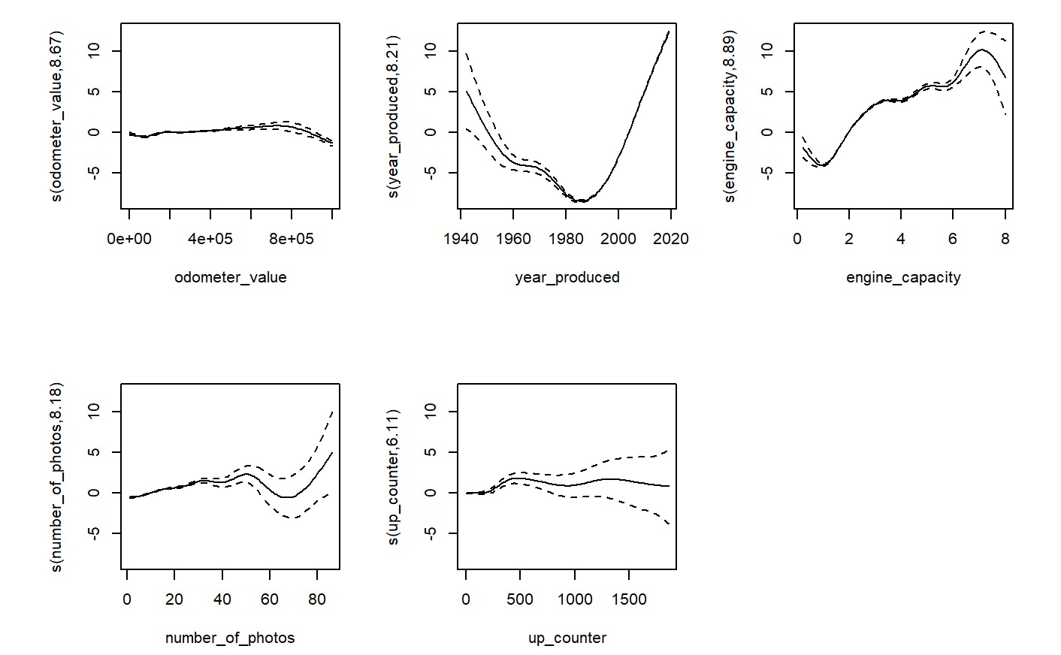
2nd Model Polynomial Term for Continuous Variable – Generalized Additive Model

Slide 35
Polynomial
lm(formula = price_normal ~ odometer_value + poly(year_produced,
2) + sin(engine_capacity) + poly(number_of_photos, 2) + up_counter +
manufacturer_name + color + transmission + engine_fuel +
body_type + has_warranty + state + drivetrain + is_exchangeable +
state, data = df)
Residual standard error: 2.2 on 38426 degrees of freedom
Multiple R-squared: 0.883, Adjusted R-squared: 0.883
F-statistic: 3.1e+03 on 94 and 38426 DF, p-value: <2e-16

Slide 36
3rd Model Both Interaction Terms
lm(formula = price_normal ~ odometer_value * poly(year_produced,
2) + sin(engine_capacity) + poly(number_of_photos, 2) + up_counter +
manufacturer_name + color + transmission + engine_fuel +
body_type + has_warranty + state + drivetrain + is_exchangeable +
state, data = df)
Residual standard error: 2.19 on 38424 degrees of freedom
Multiple R-squared: 0.885, Adjusted R-squared: 0.885
F-statistic: 3.09e+03 on 96 and 38424 DF, p-value: <2e-16

Slide 37
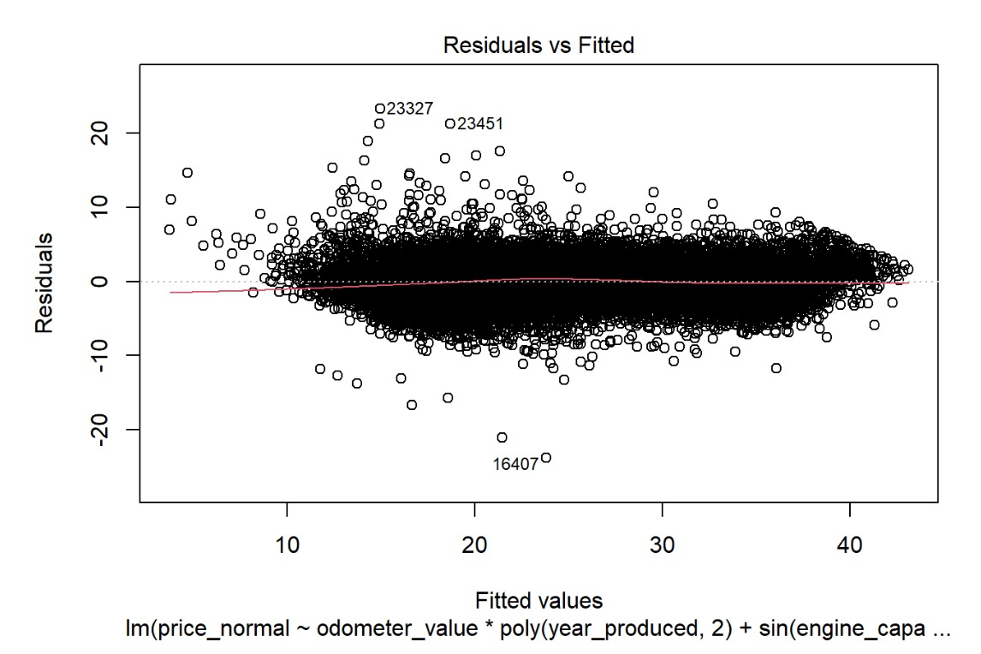
3rd Model Both Interaction Terms

Slide 38
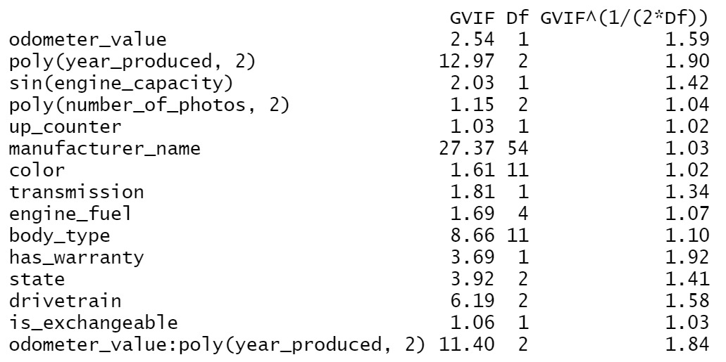
3rd Model Both Interaction Terms

Slide 39
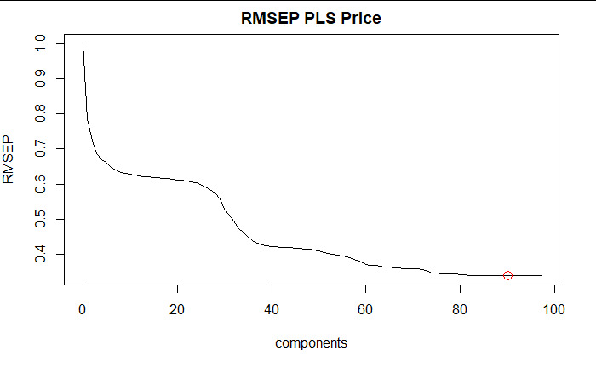
Partial Least Square Model

Slide 40
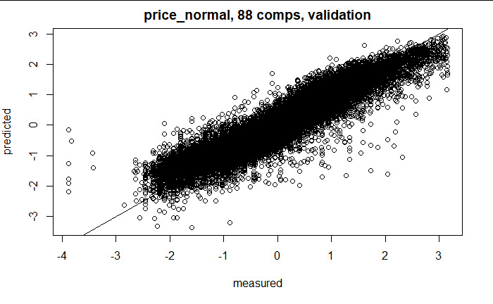
Partial Least Square Model

Slide 41
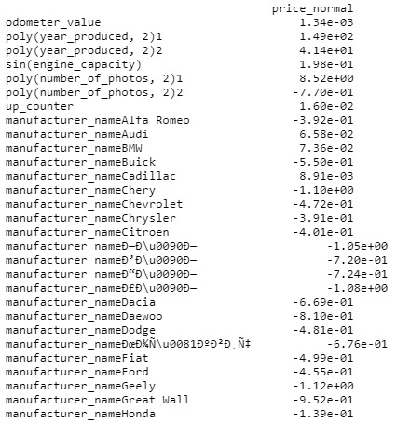
Final Coefficient

Slide 42
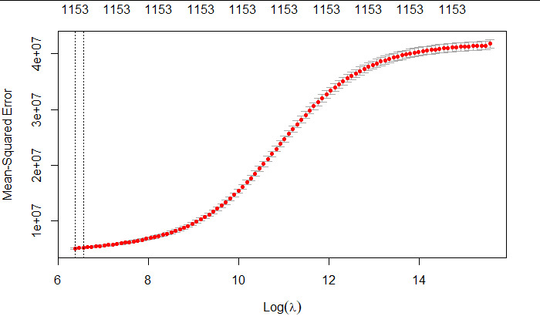
Ridge Regression
Ridge : lambda=582
R squared = 0.885
validation MSE =4588638
Notes:
Ridge regression: Cross validation results MSE vs log(lambda)
The first line shows the lambda at the lowest MSE

Slide 43
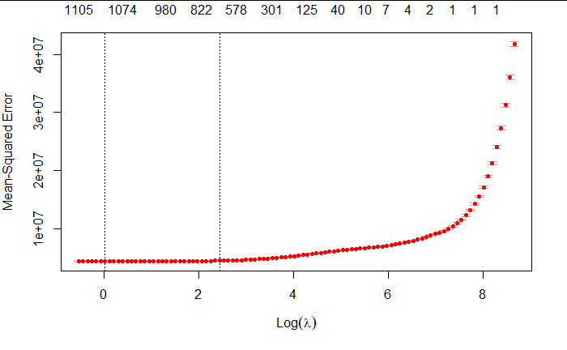
Lasso Regression
Lasso
validation MSE 3.36e+10
R squared 0.912
Notes:
Lasso Regression: We select the lambda at the 1st line
Lasso: lambda value at lowest MSE: 1.02

Slide 44
Hypotheses Test

Slide 45
ANOVA

Slide 46
Tukey Testing

Slide 47
Prediction

Slide 48
Questions?

